Slide 1
Análisis precio viviendas Valdivia 8 de julio 2019

Slide 2
Descripción
Fecha Consulta: 8 de Julio de 2019
Datos de venta de departamentos y casas en Valdivia
Fuente: portalinmobiliario

Slide 3
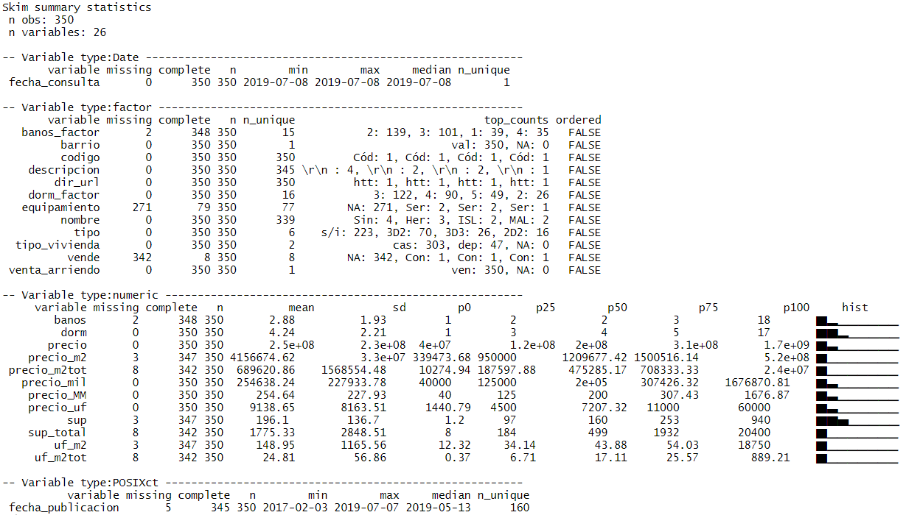
Datos Promedio

Slide 4
Tablas resumen

Slide 5
Datos por Dormitorios/Baño: Precio Total (MM y UF)
tipo_vivienda | tipo | count | precio.p10 | precio.mean | precio.p90 | precioUF.p10 | precioUF.mean | precioUF.p90
departamento | 1D1B | 2 | $ 67 | $ 80 | $ 93 | $ 2,398 | $ 2,865 | $ 3,331
departamento | 2D1B | 5 | $ 52 | $ 70 | $ 92 | $ 1,865 | $ 2,527 | $ 3,339
departamento | 2D2B | 8 | $ 79 | $ 134 | $ 180 | $ 2,851 | $ 4,821 | $ 6,464
departamento | 3D2B | 17 | $ 88 | $ 141 | $ 187 | $ 3,166 | $ 5,069 | $ 6,691
departamento | 3D3B | 4 | $ 201 | $ 220 | $ 244 | $ 7,203 | $ 7,875 | $ 8,729
casa | 1D1B | 3 | $ 138 | $ 515 | $ 943 | $ 4,996 | $ 18,495 | $ 33,754
casa | 2D1B | 5 | $ 50 | $ 106 | $ 180 | $ 1,807 | $ 3,804 | $ 6,477
casa | 2D2B | 8 | $ 63 | $ 95 | $ 150 | $ 2,281 | $ 3,443 | $ 5,412
casa | 3D2B | 53 | $ 73 | $ 149 | $ 232 | $ 2,642 | $ 5,346 | $ 8,313
casa | 3D3B | 22 | $ 139 | $ 256 | $ 401 | $ 4,968 | $ 9,165 | $ 14,364

Slide 6
Datos por Dormitorios/Baño: Precio por m2 total
tipo_vivienda | tipo | count | uf_m2.p10 | uf_m2.mean | uf_m2.p90 | uf_m2tot.p10 | uf_m2tot.mean | uf_m2tot.p90
departamento | 1D1B | 2 | $73 | $87 | $101 | $71 | $77 | $83
departamento | 2D1B | 5 | $41 | $156 | $360 | $39 | $155 | $360
departamento | 2D2B | 8 | $49 | $69 | $88 | $49 | $67 | $88
departamento | 3D2B | 17 | $45 | $57 | $66 | $43 | $55 | $64
departamento | 3D3B | 4 | $66 | $69 | $72 | $62 | $67 | $72
casa | 1D1B | 3 | $40 | $46 | $52 | $1 | $6 | $12
casa | 2D1B | 5 | $32 | $44 | $62 | $6 | $24 | $48
casa | 2D2B | 8 | $23 | $37 | $49 | $1 | $9 | $17
casa | 3D2B | 53 | $32 | $42 | $57 | $1 | $15 | $29
casa | 3D3B | 22 | $34 | $48 | $63 | $2 | $11 | $25
Superficie m2
tipo_vivienda | tipo | count | sup.p10 | sup.mean | sup.p90 | supTotal.p10 | supTotal.mean | supTotal.p90
departamento | 1D1B | 2 | 33 | 33 | 33 | 34 | 37 | 40
departamento | 2D1B | 5 | 22 | 43 | 57 | 22 | 45 | 59
departamento | 2D2B | 8 | 56 | 69 | 81 | 56 | 71 | 81
departamento | 3D2B | 17 | 69 | 86 | 100 | 72 | 90 | 112
departamento | 3D3B | 4 | 108 | 115 | 128 | 108 | 119 | 137
casa | 1D1B | 3 | 118 | 367 | 638 | 3,142 | 5,993 | 9,080
casa | 2D1B | 5 | 55 | 82 | 120 | 91 | 1,694 | 4,860
casa | 2D2B | 8 | 68 | 94 | 122 | 185 | 1,559 | 5,200
casa | 3D2B | 53 | 72 | 123 | 205 | 125 | 2,203 | 7,800
casa | 3D3B | 22 | 137 | 195 | 273 | 283 | 2,615 | 5,300

Slide 7
BOXPLOT

Slide 8
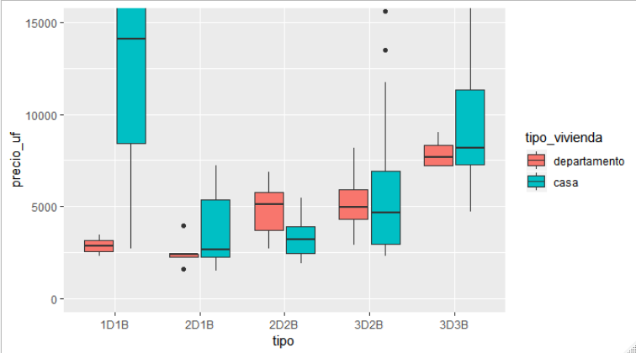
Precio vs Tipo

Slide 9
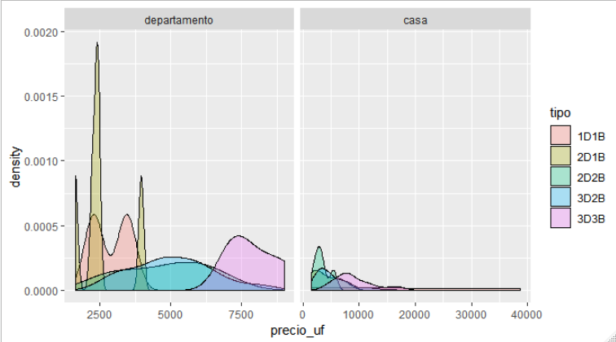
Distribución precio por Tipo

Slide 10
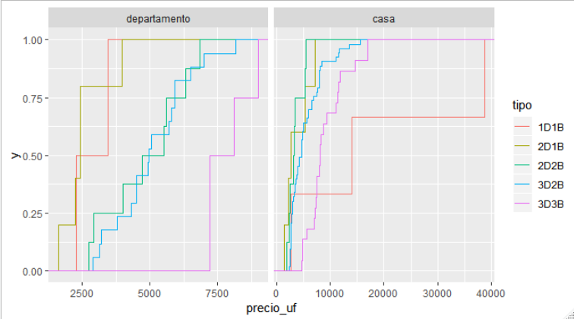
Distribución precio por Tipo

Slide 11
Scatter

Slide 12
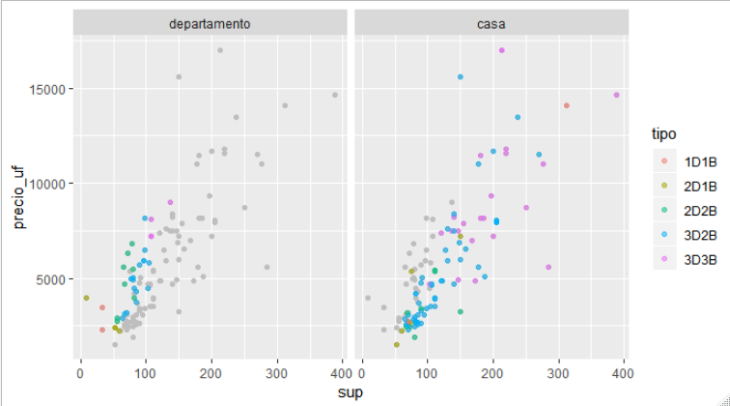
Precio vs Superficie útil

Slide 13
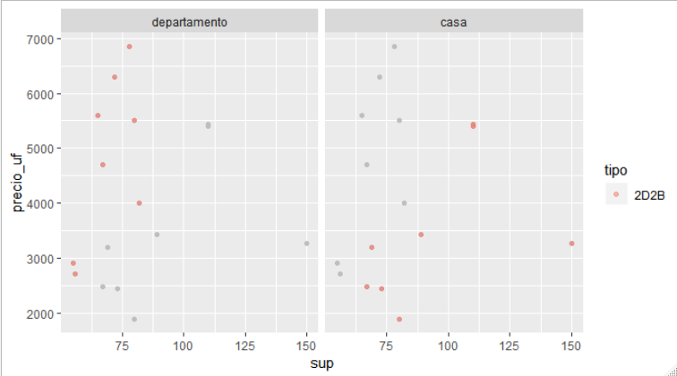
Precio vs Superficie útil: 2D2B

Slide 14
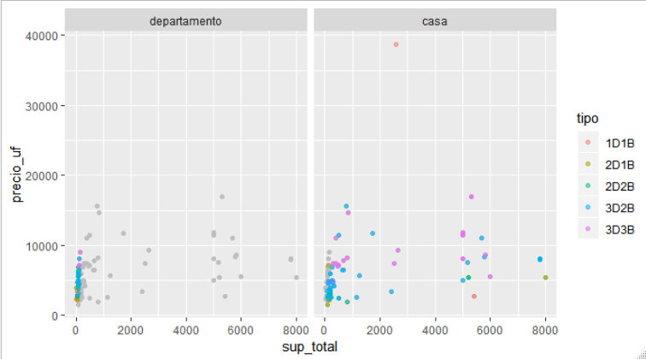
Precio vs Superficie total

Slide 15
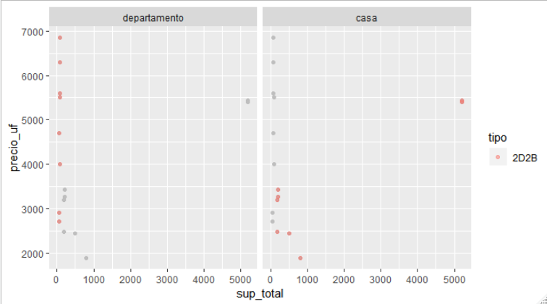
Precio vs Superficie total: 2D2B

Slide 16
Dividendos estimados según precio

Slide 17
Dividendo aproximado a un plazo de 20 años
 |  | Porcentaje_Pie | Valor
 |  | 10% |  | 15% |  | 20%
Precio_UF | Tasa_Interes_Anual | Dividendo | Renta Requerida | Dividendo | Renta Requerida | Dividendo | Renta Requerida
4000 | 3.00% | $547,048 | $2,188,191 | $516,656 | $2,066,625 | $486,265 | $1,945,059
 | 3.50% | $571,370 | $2,285,480 | $539,627 | $2,158,509 | $507,885 | $2,031,538
 | 4.00% | $596,197 | $2,384,786 | $563,075 | $2,252,298 | $529,953 | $2,119,810
 | 4.21% | $606,770 | $2,427,081 | $573,061 | $2,292,243 | $539,351 | $2,157,405
 | 5.00% | $647,298 | $2,589,192 | $611,337 | $2,445,348 | $575,376 | $2,301,504
4500 | 3.00% | $615,429 | $2,461,715 | $581,238 | $2,324,953 | $547,048 | $2,188,191
 | 3.50% | $642,791 | $2,571,165 | $607,081 | $2,428,323 | $571,370 | $2,285,480
 | 4.00% | $670,721 | $2,682,885 | $633,459 | $2,533,835 | $596,197 | $2,384,786
 | 4.21% | $682,617 | $2,730,466 | $644,693 | $2,578,774 | $606,770 | $2,427,081
 | 5.00% | $728,210 | $2,912,841 | $687,754 | $2,751,017 | $647,298 | $2,589,192
5000 | 3.00% | $683,810 | $2,735,239 | $645,820 | $2,583,281 | $607,831 | $2,431,324
 | 3.50% | $714,213 | $2,856,850 | $674,534 | $2,698,137 | $634,856 | $2,539,423
 | 4.00% | $745,246 | $2,980,983 | $703,843 | $2,815,373 | $662,441 | $2,649,763
 | 4.21% | $758,463 | $3,033,851 | $716,326 | $2,865,304 | $674,189 | $2,696,757
 | 5.00% | $809,123 | $3,236,491 | $764,171 | $3,056,685 | $719,220 | $2,876,880
5500 | 3.00% | $752,191 | $3,008,763 | $710,402 | $2,841,610 | $668,614 | $2,674,456
 | 3.50% | $785,634 | $3,142,535 | $741,988 | $2,967,950 | $698,341 | $2,793,365
 | 4.00% | $819,770 | $3,279,081 | $774,227 | $3,096,910 | $728,685 | $2,914,739
 | 4.21% | $834,309 | $3,337,236 | $787,959 | $3,151,834 | $741,608 | $2,966,432
 | 5.00% | $890,035 | $3,560,140 | $840,589 | $3,362,354 | $791,142 | $3,164,568
6000 | 3.00% | $820,572 | $3,282,287 | $774,984 | $3,099,938 | $729,397 | $2,917,588
 | 3.50% | $857,055 | $3,428,221 | $809,441 | $3,237,764 | $761,827 | $3,047,307
 | 4.00% | $894,295 | $3,577,179 | $844,612 | $3,378,447 | $794,929 | $3,179,715
 | 4.21% | $910,155 | $3,640,622 | $859,591 | $3,438,365 | $809,027 | $3,236,108
 | 5.00% | $970,947 | $3,883,789 | $917,006 | $3,668,023 | $863,064 | $3,452,257
6500 | 3.00% | $888,953 | $3,555,811 | $839,566 | $3,358,266 | $790,180 | $3,160,721
 | 3.50% | $928,476 | $3,713,906 | $876,894 | $3,507,577 | $825,312 | $3,301,249
 | 4.00% | $968,819 | $3,875,278 | $914,996 | $3,659,985 | $861,173 | $3,444,691
 | 4.21% | $986,002 | $3,944,007 | $931,224 | $3,724,895 | $876,446 | $3,505,784
 | 5.00% | $1,051,859 | $4,207,438 | $993,423 | $3,973,691 | $934,986 | $3,739,945
7000 | 3.00% | $957,334 | $3,829,335 | $904,148 | $3,616,594 | $850,963 | $3,403,853
 | 3.50% | $999,898 | $3,999,591 | $944,348 | $3,777,391 | $888,798 | $3,555,192
 | 4.00% | $1,043,344 | $4,173,376 | $985,380 | $3,941,522 | $927,417 | $3,709,668
 | 4.21% | $1,061,848 | $4,247,392 | $1,002,856 | $4,011,426 | $943,865 | $3,775,459
 | 5.00% | $1,132,772 | $4,531,087 | $1,069,840 | $4,279,360 | $1,006,908 | $4,027,633
7500 | 3.00% | $1,025,715 | $4,102,859 | $968,731 | $3,874,922 | $911,746 | $3,646,985
 | 3.50% | $1,071,319 | $4,285,276 | $1,011,801 | $4,047,205 | $952,283 | $3,809,134
 | 4.00% | $1,117,869 | $4,471,474 | $1,055,765 | $4,223,059 | $993,661 | $3,974,644
 | 4.21% | $1,137,694 | $4,550,777 | $1,074,489 | $4,297,956 | $1,011,284 | $4,045,135
 | 5.00% | $1,213,684 | $4,854,736 | $1,146,257 | $4,585,028 | $1,078,830 | $4,315,321

Slide 18
Datos arriendo VALDIVIA

Slide 19
Datos por Dormitorios/Baño: Precio Total Arriendo
tipo_vivienda | tipo | count | precio.p10 | precio.mean | precio.p90 | precioUF.p10 | precioUF.mean | precioUF.p90
departamento | 1D1B | 4 | $349 | $398 | $444 | $13 | $14 | $16
departamento | 2D1B | 6 | $315 | $362 | $425 | $11 | $13 | $15
departamento | 2D2B | 6 | $460 | $492 | $525 | $17 | $18 | $19
departamento | 3D2B | 4 | $430 | $453 | $485 | $15 | $16 | $17
casa | 1D1B | 2 | $270 | $350 | $430 | $10 | $13 | $15
casa | 2D1B | 2 | $240 | $280 | $320 | $9 | $10 | $11
casa | 2D2B | 3 | $504 | $540 | $584 | $18 | $19 | $21
casa | 3D2B | 11 | $480 | $591 | $790 | $17 | $21 | $28

Slide 20
Datos por Dormitorios/Baño: Arriendo por m2 total
tipo_vivienda | tipo | count | precio_m2.p10 | precio_m2.mean | precio_m2.p90 | precio_m2tot.p10 | precio_m2tot.mean | precio_m2tot.p90
departamento | 1D1B | 4 | $6,967 | $9,322 | $11,135 | $6,089 | $8,433 | $10,525
departamento | 2D1B | 6 | $4,894 | $6,057 | $7,006 | $4,894 | $6,010 | $6,866
departamento | 2D2B | 6 | $6,815 | $7,292 | $7,692 | $6,638 | $7,154 | $7,692
departamento | 3D2B | 4 | $5,574 | $18,053 | $39,673 | $5,574 | $11,334 | $20,860
casa | 1D1B | 2 | $5,500 | $7,500 | $9,500 | $3,200 | $4,000 | $4,800
casa | 2D1B | 2 | $4,800 | $5,600 | $6,400 | $1,203 | $2,713 | $4,223
casa | 2D2B | 3 | $3,700 | $6,143 | $8,443 | $920 | $3,400 | $5,880
casa | 3D2B | 11 | $3,621 | $5,202 | $7,710 | $366 | $1,702 | $3,328
Superficie m2
tipo_vivienda | tipo | count | sup.p10 | sup.mean | sup.p90 | supTotal.p10 | supTotal.mean | supTotal.p90
departamento | 1D1B | 4 | 37 | 45 | 56 | 38 | 50 | 61
departamento | 2D1B | 6 | 50 | 61 | 70 | 51 | 61 | 70
departamento | 2D2B | 6 | 63 | 68 | 76 | 65 | 69 | 78
departamento | 3D2B | 4 | 25 | 59 | 88 | 30 | 61 | 88
casa | 1D1B | 2 | 46 | 48 | 50 | 60 | 100 | 140
casa | 2D1B | 2 | 50 | 50 | 50 | 85 | 225 | 365
casa | 2D2B | 3 | 61 | 112 | 176 | 272 | 1,040 | 1,808
casa | 3D2B | 11 | 87 | 121 | 151 | 178 | 988 | 2,200

Slide 21
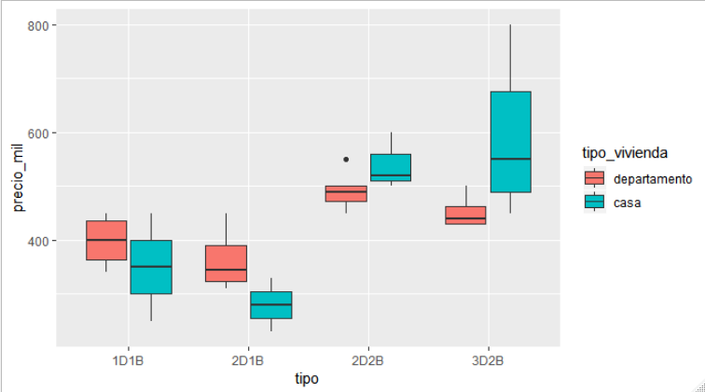
Boxplot por Tipo

Slide 22
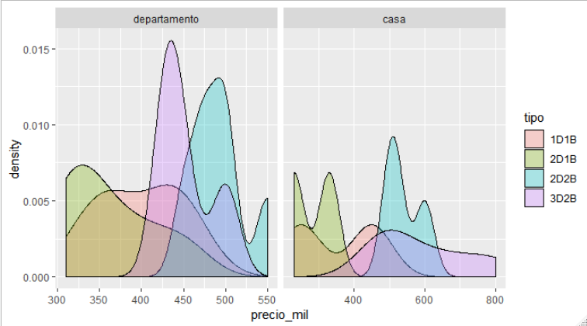
Distribución precio por Tipo

Slide 23
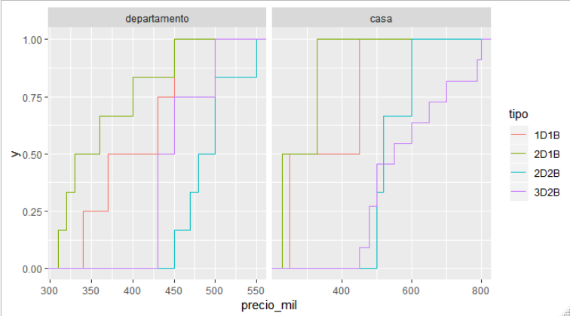
Distribución precio por Tipo

Slide 24
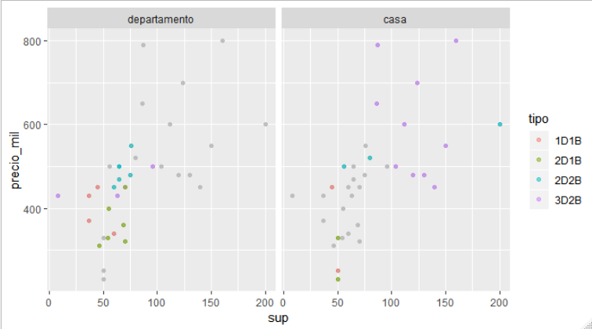
Precio vs Superficie construida

Slide 25
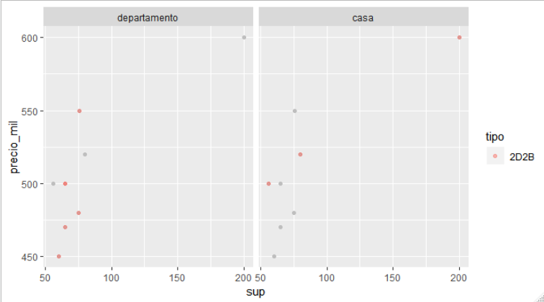
Precio vs Superficie construida: 2D2B

